Slide 1
SecretOps for StartUps Using 1Password
Legends Room
11:50 to 12:10

Slide 2



Mya Pitzeruse
Director of Engineering @ CrabNebula
5+ years @ start ups
Formally Storj, Indeed, IBM
—
👩🏼‍🍼Mom
🏒Avid hockey player
⛑️Search and Rescue volunteer
Notes:
CrabNebula
Company behind Tauri open source project
Spent last year building a globally available distribution network for desktop applications
“Third-party app store” kinda solution
Work history
Mom
1 kid, 3 dogs, 2 cats
Hockey player
27 years
Broke my first bone 5mo ago
Search and rescue
Volunteer to search for missing persons… usually elderly folks with dementia or children at large events
Can probably beat you in a game of hide-and-seek
QR code to LinkTree
Links to social can be found at the bottom…
Lots of other fun things on there too…

Slide 3

Notes:
Often face some interesting challenges, especially in devops…
Work with a limited operations staff…
NEED to involve more members of the development team…
Often need to decide between doing something the “right” way, or doing something in a “reasonable” way. Trade offs:
Cost
Technical requirements
Complexity

Slide 4

MICROSERVICES
Notes:
Systems today are becoming increasingly more complex.
Operations are expected to be experts on more systems, spreading them thin or requiring more support.
You can see this both in private code bases, as well as public open-source projects as well.
Grafana + Prometheus now require Loki, Tempo, Mimir, or Thanos….
Securing runtime environments requires numerous systems from policy-enforcement agents, to low-level networking agents.
Many monolithic systems are splitting their runtime components into microservices to address scaling challenges, while also increasing the complexity of their system.
Software license changes often leave organizations scrambling to figure out whether their use of a system still falls within the scope of the new license.
Secret operations is one area we see a large number of solutions varying in complexity.

Slide 5

Just pay for our cloud service
Notes:
The problem is… StartUps and SMBs are often overlooked when setting pricing.
Limited features for a price they can afford
At the expense of doing things “right”
https://www.wsj.com/articles/indeeds-price-changes-leave-small-businesses-feeling-burned-43edf62
SMBs were the initial target market

Slide 6
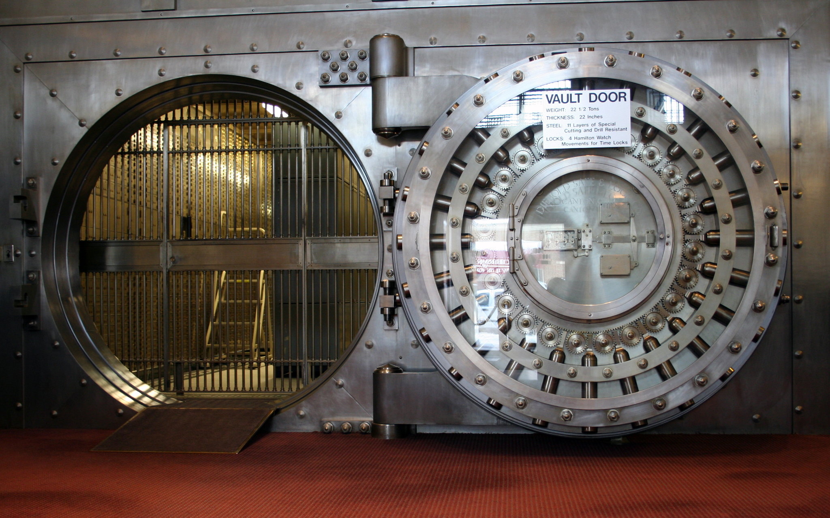
https://en.wikipedia.org/wiki/Bank_vault
Notes:
Increasing need to protect data
User / Customer information
Employee information
Ownership
Walk away from a solution that you know is not working
With your data
Knowing it hasn’t been compromised
Global Data Protection Regulations
US proposes 'know your customer' cloud computing requirements
- Reuters

Slide 7
Wants and Needs
Accessible solution
Doesn’t break the bank
Offers a reasonably secure solution
Platform agnostic (sorry Kubernetes folks)
Notes:
Accessible solution
Used by both developers, operations, traditional IT
Doesn’t break the bank
Offers a reasonably secure solution
It doesn’t need to be “perfect”
Ideally should enable easy migration
Platform agnostic (sorry Kubernetes folks)
Should work with docker
fly.io
Heroku
etc….

Slide 8

SOPS
Encrypt the values in common configuration files.
Supports various KMS solutions out of box.
Once a file is decrypted, the individual has access to all the secrets within that file.
Some alternatives, but none are as feature rich.
Notes:
SOPS
YAML, JSON, env, properties, and more.
No support for symmetric key encryption.
GPG, AWS KMS, Google KMS, Azure Key Vault, Vault, and many more…
https://github.com/getsops/sops
https://opensource.com/article/19/2/secrets-management-tools-git

Slide 9

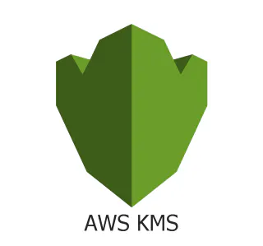

Notes:
KMS technologies are a dime a dozen
Many clouds provide hosted solutions
If you want to own your data, Vault is really the only option at the time of recording…

Slide 10
Notes:
Popular option amongst larger organizations for handling centralized secret management.
Secrets engine (dynamically generate credentials for databases)
Auth methods (login with… assign identities)
Audit sinks
Policies
Enforcement
Clustering
Not easy to do
Requires 3 or more instances
Can be enabled with Consul
Must be unsealed by an operator after each restart using k-of-m keys..
Shamir Secret Sharing
Possible Cons
Relicensing concerns
Recently acquired by IBM
Vault is a great piece of technology…. But it’s complex, and often overkill for smaller environments.
If you’re going to run SOPS + Vault, you might just look at using Vault directly and dropping the SOPS support.
In Kubernetes, Vault has an operator and secret injector process that can insert secret values directly into your pods that are created in the cluster.

Slide 11

1Password
Notes:
Most organizations use some sort of password management solutions these days.
Popular choice among organizations.
Reasonably priced solution on the market.
Large number of developer focused features.
SSH key management, GPG agent integrations, git commit signing, command line tool
Can make repeatable setup of machines easy and intuitive
Other notable features…
Generate secure password
Template items for easy creation
Item history (audit log)

Slide 12
Secret references
Usage op://VAULT_NAME/ITEM_NAME/ATTRIBUTE_NAME
Basic op://company_qa/example_database/password
Advanced op://company_${TARGET_ENV}/example_database/password
Notes:
There are a few different solutions that you can leverage.
Regardless, you’ll need to be familiar with how these secret references look.

Slide 13
Command line - env files
op run --env-file 1password.env docker compose up -d
# 1password.env
DDA_POSTGRES_VERSION="latest"
DDA_POSTGRES_USER="op://DevOpsDays-demo-${TARGET_ENV}/postgres/user"
DDA_POSTGRES_PASSWORD="op://DevOpsDays-demo-${TARGET_ENV}/postgres/password"
Notes:
Ideal for small to medium sized companies with a small number of operationally focused individuals.
https://github.com/mjpitz/mjpitz/blob/main/infra/helm/.env

Slide 14
Command line - configuration files
op inject -i base.json -o config.json
# base.json
{
"dda_postgres_version": "latest",
"dda_postgres_user": "{{ op://DevOpsDays-demo-${TARGET_ENV}/postgres/user }}",
"dda_postgres_password": "{{ op://DevOpsDays-demo-${TARGET_ENV}/postgres/password }}"
}
Notes:
Ideal for small to medium sized companies with a small number of operationally focused individuals.
https://github.com/mjpitz/mjpitz/blob/main/infra/helm/.env

Slide 15
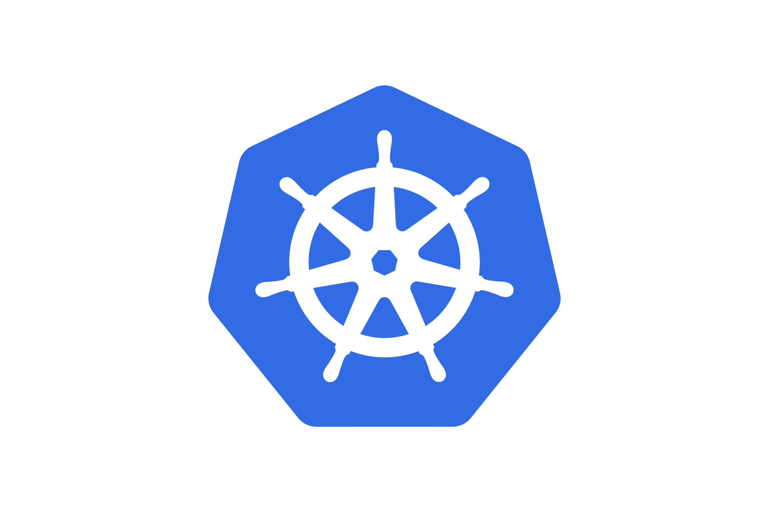
Kubernetes
Operator => Push items into 1Password Vaults.
Injector => Replaces secret references in Kubernetes resource with values.
The HashiCorp Vault operator is similar, but different…
Notes:
Operator
https://developer.1password.com/docs/k8s/k8s-operator/
Shorthand for a service that responds to resources in Kubernetes
Operators can come in all shapes and sizes
Injector
https://developer.1password.com/docs/k8s/k8s-injector
Webhook that mutates resources that are created / updated in the Kubernetes API
Looks at secrets, configmaps, and pods to replace secret references with their associated values
HashiCorp Vault
Does have an operator/injector… works a little different
Uses annotations to inject secrets into the pods
IMO… the 1Password operator / injector is easier

Slide 16
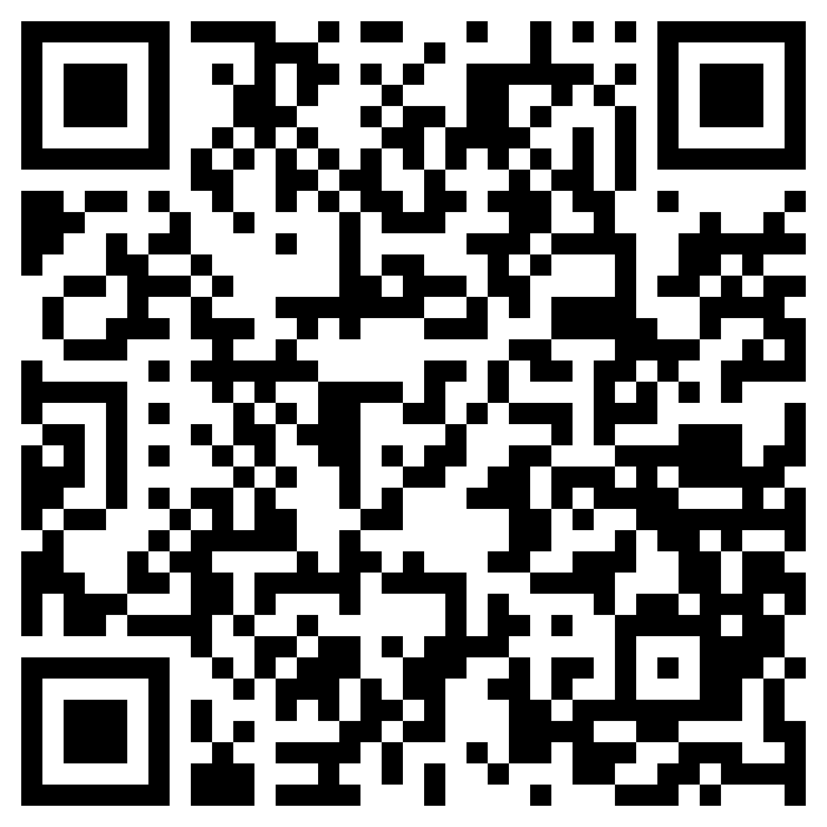
Demo

Slide 17
Conclusion
1Password is accessible to non-operations focused staff.
Likely a tool you’re already paying for.
1Password may not be as fully featured as something like Vault.
Works with environment variables and configuration files.

Slide 18

Thank you!

